Slide 1
LINUX

Slide 2
Introduction of Linux
The Linux Operating System is an OS created in the early 1990s by Linus Torvalds as a research project.
Free and open-source. (GNU)
Multiple distribution like: UBUNTU, OPENSUSE, LINUX MINT, FEDORA etc.
Android is based on (a modified version of) Linux.
Linux Runs on All of the Top 500 Supercomputers.

Slide 3
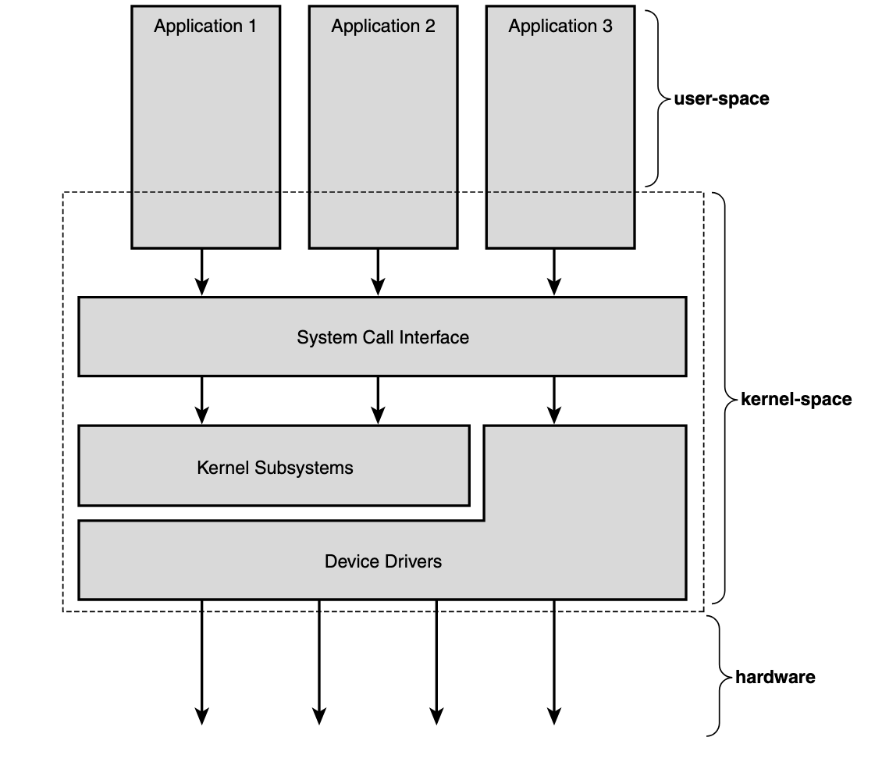
Relationship between applications, the kernel, and hardware.
Notes:
<number>

Slide 4
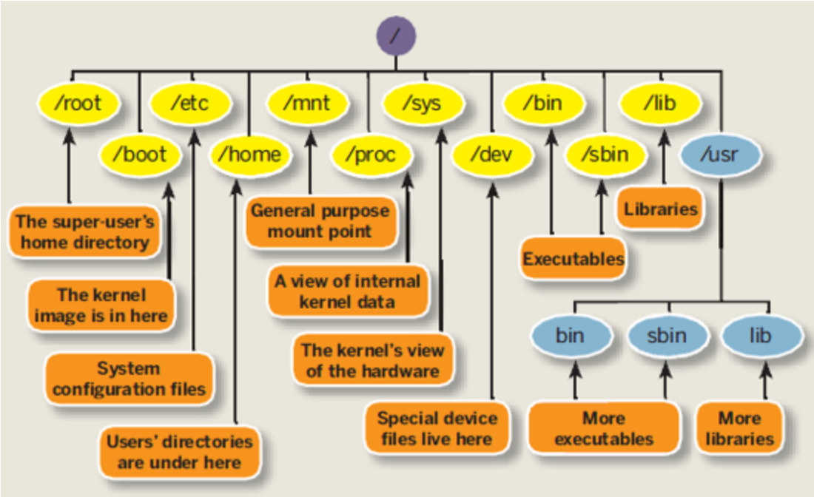
Linux File Structure
Notes:
<number>

Slide 5
What is the shell?
A shell is a command interpreter that exposes an interface to the user to work with the underlying operating system.
Terminal is a program that opens in a window and lets users interact with the shell.
cat /etc/shells
chsh
Notes:
<number>

Slide 6
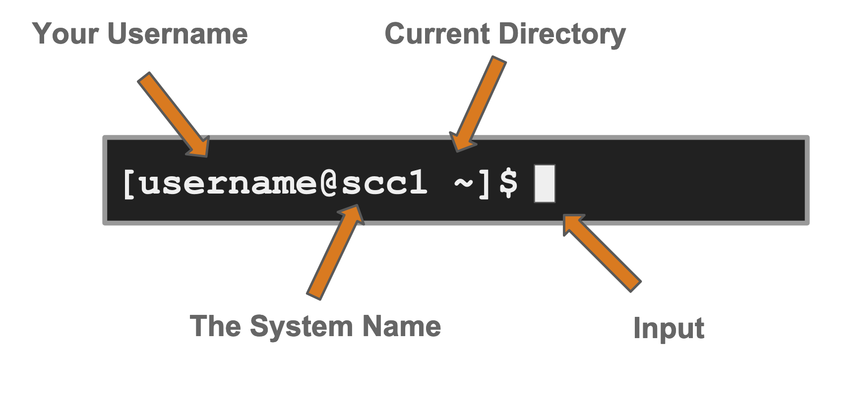
Terminal prompt In Linux “ ~ ” is a shorthand for your home directory.
In Linux “ ~ ” is a shorthand for your home directory.
Notes:
<number>

Slide 7
SSH
SSH, or Secure Shell, is a remote administration protocol that allows users to control and modify their remote servers over the Internet.
port 22
ssh root@101.53.152.229
user-name: password
key based: public key should be in remote server (~/.ssh/authorized_keys)
ssh-keygen
eval `ssh-agent -s`
ssh-add {private_key}
Notes:
<number>

Slide 8
Create User/Group
adduser command in Linux is used to add a new user to your current Linux machine.
The command above creates the new user’s home directory and copies files from /etc/skel directory to the user’s home directory.
su will start a new shell as another user.
sudo useradd -g users -G wheel,developers username
Notes:
<number>

Slide 9
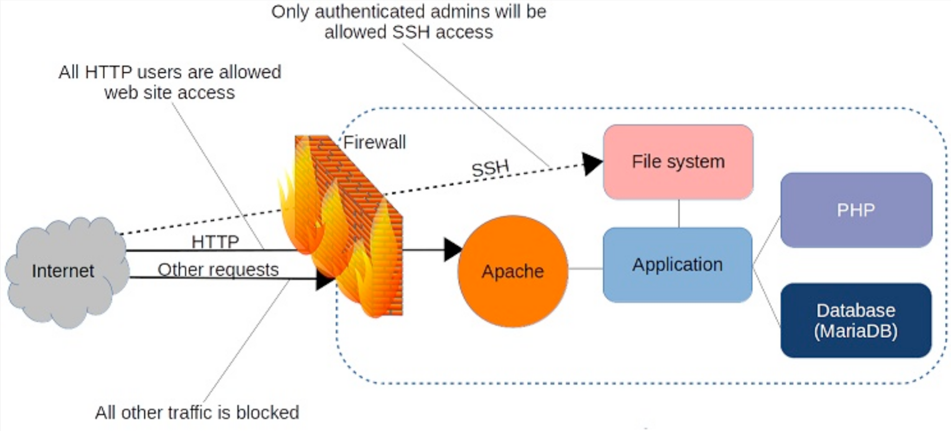
Firewall
Notes:
<number>

Slide 10
iptable
A Linux firewall is a device that inspects Network traffic ( Inbound /Outbound connections ) and makes a decision to pass or filter out the traffic.
iptables is a tool for managing firewall rules on a Linux machine.
open port:
iptables -A INPUT -p tcp --dport 8080 -j ACCEPT
close port:
iptables -D INPUT {line number}
reject port :
iptables -A INPUT -p tcp --dport 8080 -j REJECT
Notes:
<number>

Slide 11
Virtual Private Network
A VPN, as the name implies, is a means of creating a private network across an untrusted network such as the internet.
to securely connect isolated local area networks (LANs) across the internet
to allow mobile users remote access to a corporate network using the internet
to control access within an intranet environment.
VPN client
VPN server
VPN tunnel
Notes:
<number>

Slide 12
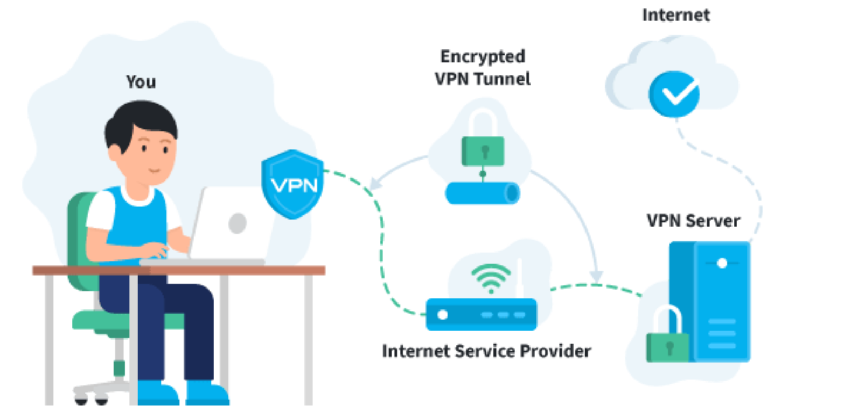
Notes:
<number>

Slide 13
Network flow in Linux
DNS (Domain Name Service) is a distributed and hierarchical service mapping names to IP addresses, and vice-versa.
/etc/hosts (generally only contains the most important entries.)
/etc/resolv.conf
Notes:
<number>

Slide 14
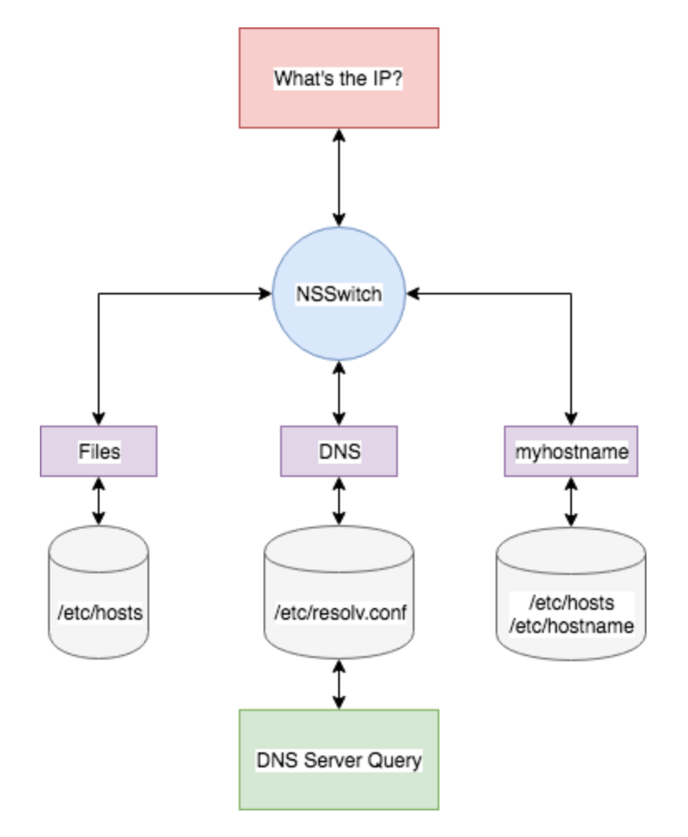
Notes:
<number>

Slide 15
Traceroute
traceroute - print the route packets trace to network host
traceroute facebook.com
Notes:
<number>

Slide 16
Basic commands
Basic Directory Operations
pwd command to print working directory
ls command to list contents of the current directory
mkdir command to make a new directory
cd command to change into a directory
rmdir command to remove a directory
Notes:
<number>

Slide 17
Basic File Operations
touch creates an empty file
echo prints its arguments to the standard output
cat shows the content of a file(s) – It reads data from the file and gives their content as output.
wc counts number of lines, words, and characters in a text file
cp command to make a copy of a file(s) or directory(s) (for directory use cp -R file_name copy_file_name)
mv command to make a copy of the source file(s) and directory(s) into the destination and remove the source at the end. Also be used to rename the file.
rm command to remove file(s) and directory(s) permanently
Notes:
<number>

Slide 18
Some other useful commands
man command to search and open the manual page of a Linux command
more command for paging through text one screenful at a time
Less command is an improved version of more command which allows backward movement in the file as well as forward movement
head command to see first lines of a file (default – 10 lines) (head -n 20 file1.txt)
tail command to see last lines of a file (10 lined by default tail -n 20 file1.txt)
Notes:
<number>

Slide 19
grep command to print lines in a file matching a pattern grep “pattern” file_name.
history command to see the commands you have typed so far.
chmod change file permissions of files. (change mode) (r, w, x(to execute)).
chown change file owner and/or group
ps output a list of currently active processes (top can be used)
Notes:
<number>

Slide 20
df command is used to get disk usage information.
kill command can send a variety of signals to a program (default TERM).
which command will return the path to the command specified
whoami to print the user name currently logged in to the terminal session
who command displays the users logged in to the system
su will start a new shell as another user
sudo is commonly used to run a command as root.
crontab command is the entry point to work with cron jobs.
Notes:
<number>

Slide 21
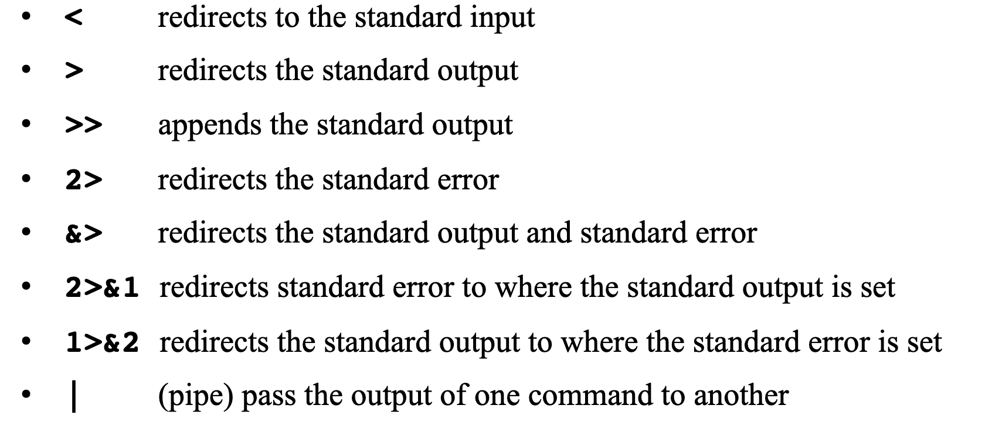
Output Redirection
Notes:
<number>

Slide 22
useful links
https://cryptography.io/en/latest/hazmat/primitives/asymmetric/
https://www.iplocation.net/public-vs-private-ip-address
https://www.csoonline.com/article/3246212/what-is-ssl-tls-and-how-this-encryption-protocol-works.html
https://ostoday.org/linux/what-are-the-components-of-linux-kernel.html
Notes:
<number>

Slide 23
Thank You openfortivpn 43.252.90.2:10443 -u himalaya.soni -p '7ZrAHVbAn3C@0dRi+Llz' --trusted-cert e2a8f53dc76043d3ea1eaf39a5f66193bd8a14382d041847ec614ab942bc7863
Paritosh Puri
E2E Networks
Notes:
<number>

